Slide 1
the dom
IN712 Web 3

Slide 2
The DOM
One of the great strengths of JavaScript is that it allows us to modify the web page from the browser on the fly (i.e. without having to request new HTML from the server)
The browser doesn’t use the HTML representation of the page when rendering and managing it.
Rather, it parses the HTML and builds a complex hierarchical data object (a tree) that represents the structure and the content of the page.
To programmatically access the elements and attributes within the HTML this programming interface (API) called the Document Object Model (DOM) is used
The HTML DOM is a standard object model and programming interface for HTML. It defines:
The HTML elements as objects (nodes)
The properties of all HTML elements
The methods to access all HTML elements
The events for all HTML elements
The HTML DOM is a standard for how to get, change, add, or delete HTML elements
Notes:
When you open a web page in your browser, the browser retrieves the
page’s HTML text and parses it. The browser builds up a model of the
document’s structure (the DOM) and then uses this model to draw the page on the
screen.
This representation of the document is one of the toys that a JavaScript
program has available in its sandbox. You can read from the model and
also change it. It acts as a live data structure: when it is modified, the
page on the screen is updated to reflect the changes.

Slide 3
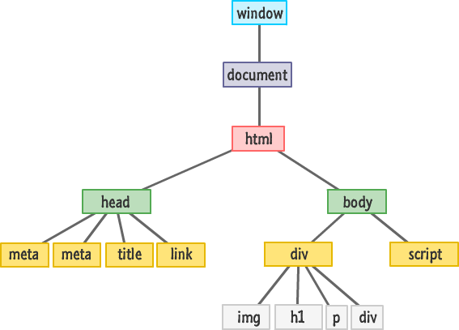
The DOM
screen
location
history
navigator

Slide 4
The DOM
Note that HTML has a naturally hierarchical structure
The <html> is the root node, and it contains two children, head and body. They in turn contain children. For example, the body can have two children, an h1 and a <p>. The p can have children of its own, a text fragment, an <i> (itself an element containing one text fragment child) and another text fragment for instance.
Note that leaf nodes are always content: text, an img or an input control. Internal nodes below the html node are always html elements.
Working with the DOM involves selecting elements of this tree, traversing this tree, processing elements of this tree, and adding and deleting elements from this tree.
Each time you modify the DOM (the structure and/or the content), the browser re-renders it. No server contact to get fresh HTML is required

Slide 5
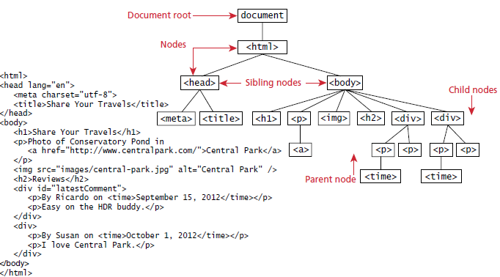
DOM tree

Slide 6
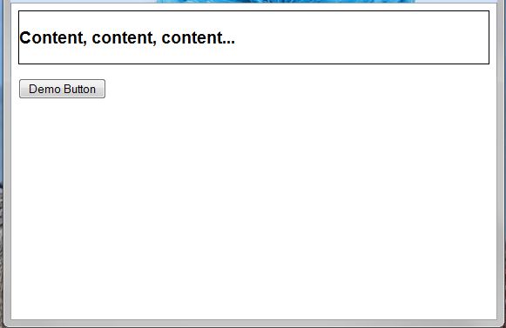
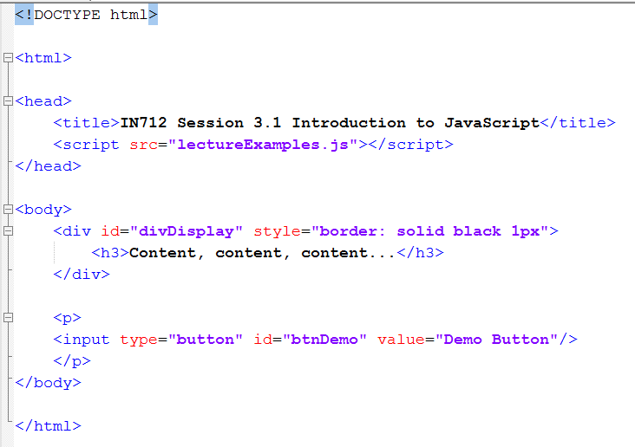
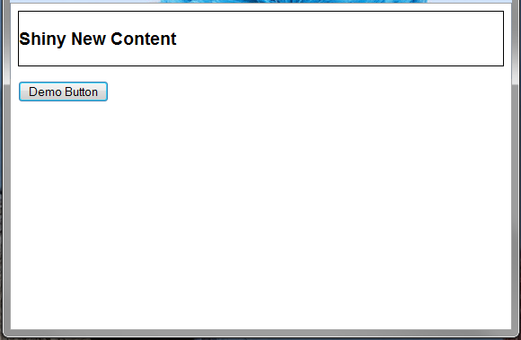
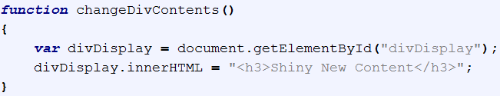
Modifying the Web Page
Notes:
*I have styled the div inline here, just so you can see the style on the same page. Never do this for real. Always put your CSS in a separate file

Slide 7

querySelector()
The querySelector() method returns the first element that matches a specified CSS selector(s) in the document.
Notes:
Before and after.

Slide 8
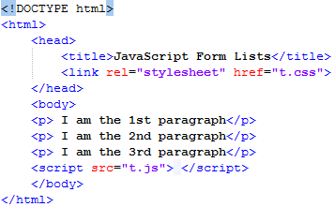
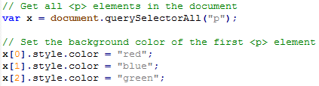
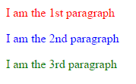
querySelectorAll()
The querySelectorAll() method returns all elements in the document that matches a specified CSS selector(s), as a static NodeList object.
The NodeList object represents a collection of nodes. The nodes can be accessed by index numbers. The index starts at 0.

Slide 9
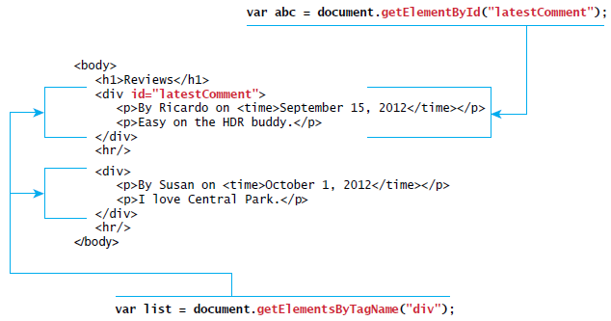
Relationship between HTML tags and getElementByID() and getElementsByTagName()

Slide 10
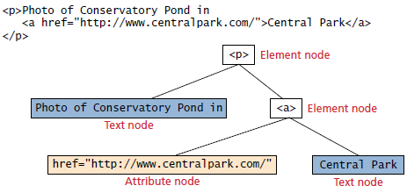
Nodes
In the DOM, each element within the HTML document is called a node
If the DOM is a tree, then each node is an individual branch
There are element nodes, text nodes, and attribute nodes
All nodes in the DOM share a common set of properties and methods
Most tasks in JavaScript involve finding a node, and then accessing or modifying it via those properties and methods

Slide 11
Element node object
The type of object returned by the method document.getElementById()
This represents an HTML element in the hierarchy, contained between the opening <> and closing </> tags for this element
An element can itself contain more elements
Since IDs must be unique in an HTML document, getElementByID() returns a single node, rather than a set of results which is the case with other selector functions

Slide 12
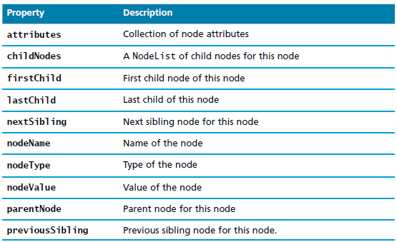
Some essential node object properties

Slide 13
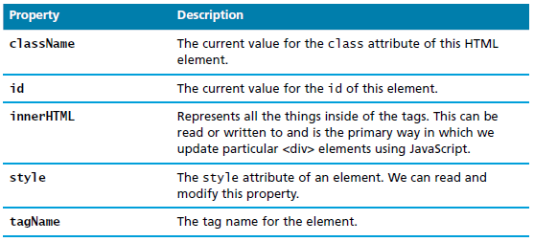
More essential node object properties

Slide 14
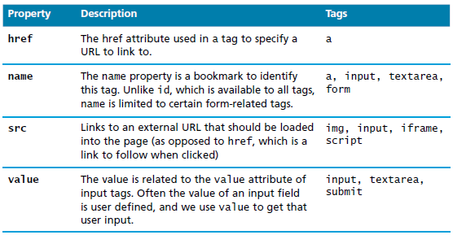
Some specific HTML DOM element properties for certain tag types

Slide 15
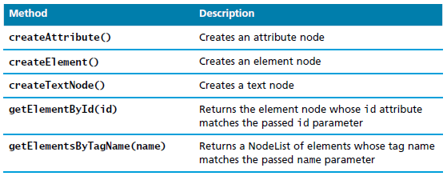
Some essential document object methods
getElementsByName(name)

Slide 16
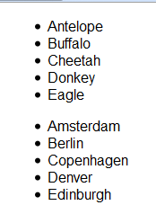
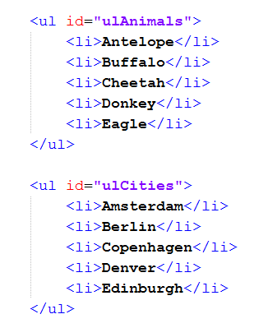
Selecting DOM nodes

Slide 17
Selecting DOM nodes
getElementById: var animalList holds (a pointer to) the first ul node.
allListItems holds all the li’s, animals and cities.
Note that you can chain these selectors. Var animalListItems holds only the animals, not the cities

Slide 18
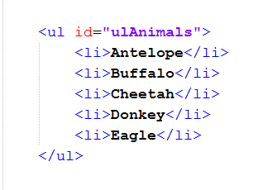
Caution!!
Be very careful when using these methods to traverse the DOM, because they are sensitive to white space in the html.
For example, these two HTML fragments look the same in the browser, but in the DOM, they are different.
The top one has 11 child nodes, 5 li and 6 line feeds
The bottom one has only the 5 li.

Slide 19
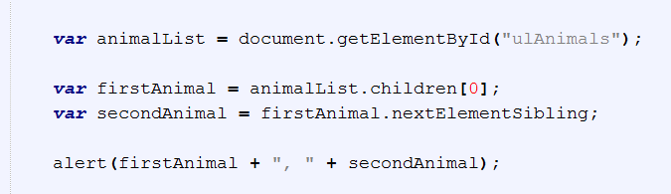
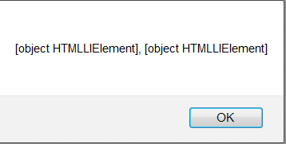
Example
Remember the tree.
These objects are <li> and when you print them, you see that
We need to access the text in the <li>, which is its child (i.e. the child of the <li> node)
Even when we get that child, we need to specify that we want its value, because text fragments are also nodes.

Slide 20
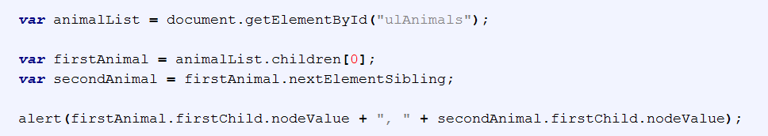
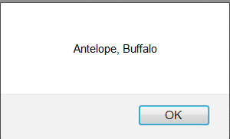
Example

Slide 21
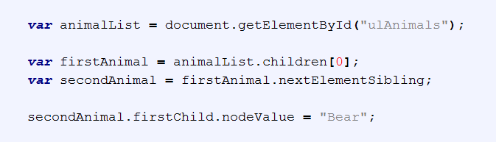
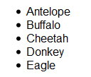
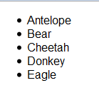
Example
Note that the nodeValue property is writable.

Slide 22
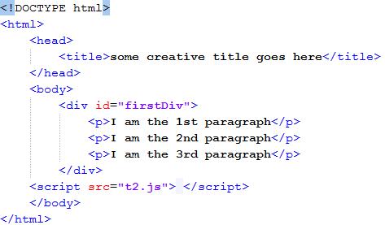
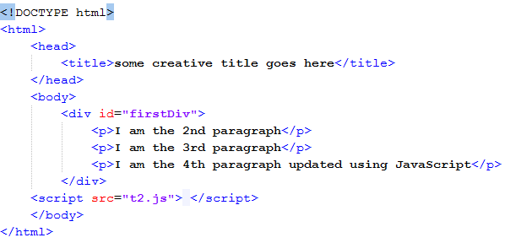
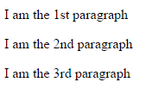
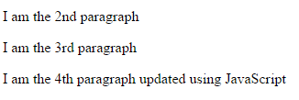
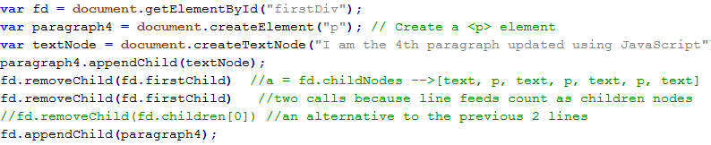

Slide 23
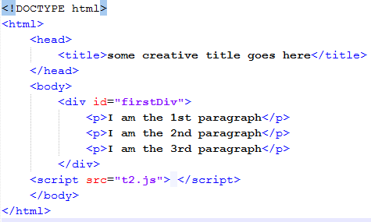
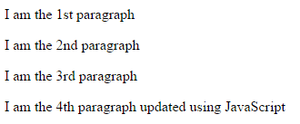
innerHTML method
The innerHTML property sets or returns the HTML content (inner HTML) of an element.

Slide 24
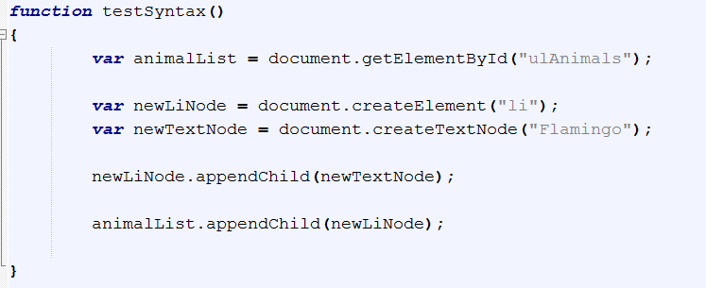
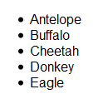
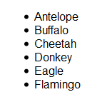
More examples on Modifying the DOM

Slide 25

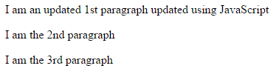
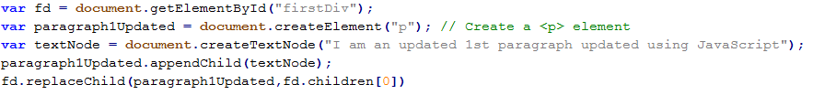
replaceChild(newNode, n)

Slide 26
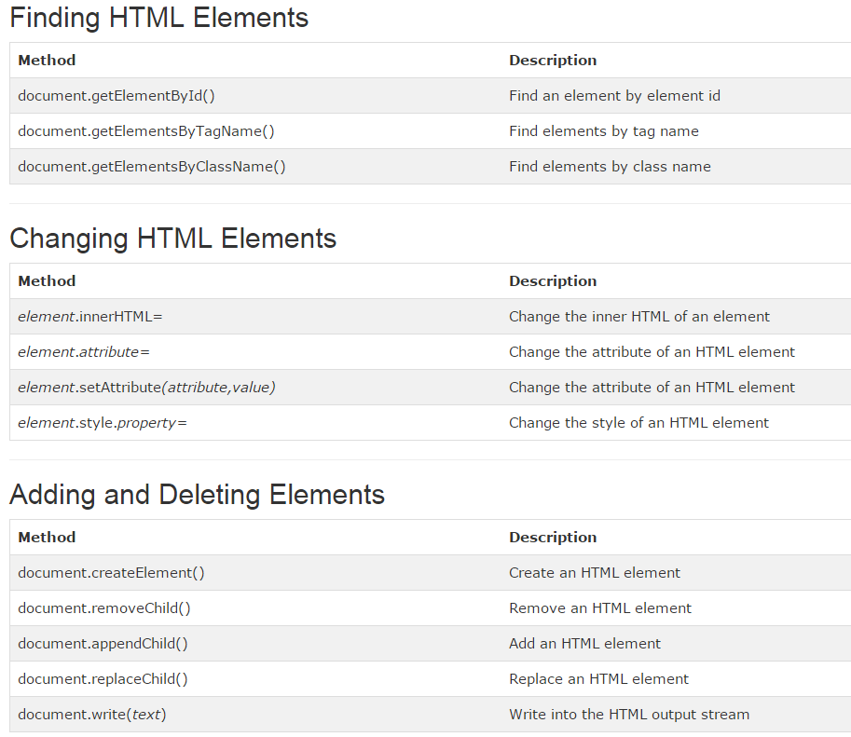

Slide 27

Changing and element’s style
We can also modify the style associated with a particular block.
We can add or remove any style using the style or className property of the Element node,

Slide 28
Performance
Note that every time you modify the DOM, the browser has to recompute and rerender the page representation. This can damage performance.
This is one of the reasons for the emergence of modern libraries for dynamically updating the DOM such as React
If you can do the same with CSS, always use CSS

Slide 29
The Window Object
screen
location
history
navigator

Slide 30
History object
History.length
history.go(-2)
history.back()
histroy.forward()

Slide 31
Location object
location.hostname
location.protocol
location.pathname
location.href = http://www.google.com
location.replace(“http://www.google.com”)

Slide 32
Navigator Object
navigator.appName
navigator.cookieEnabled
navigator.platform
navigator.userAgent
Mozilla/5.0 (Windows NT 6.3; WOW64; Trident/7.0; .NET4.0E; .NET4.0C; .NET CLR 3.5.30729; .NET CLR 2.0.50727; .NET CLR 3.0.30729; rv:11.0) like Gecko
navigator.vibrate(1)
navigator.getBattery()

Slide 33
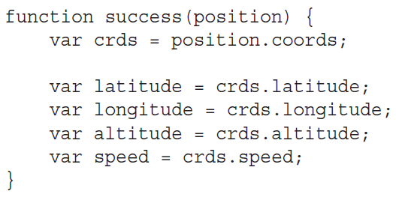
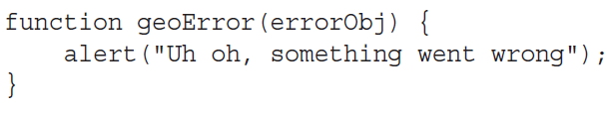
Geolocation Object
navigator.geolocation.getCurrentPosition(success, geoError)

Slide 34
Screen Object
screen.width
screen.height
screen.orientation

Slide 35
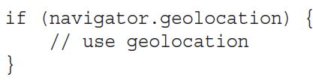
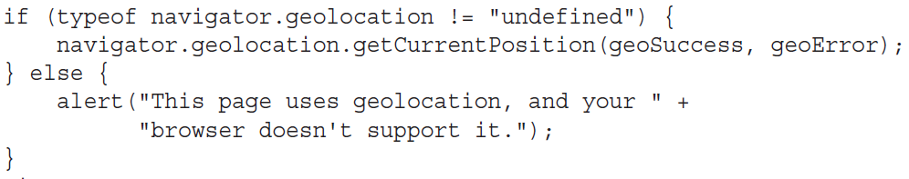
Feature Detection

Slide 36
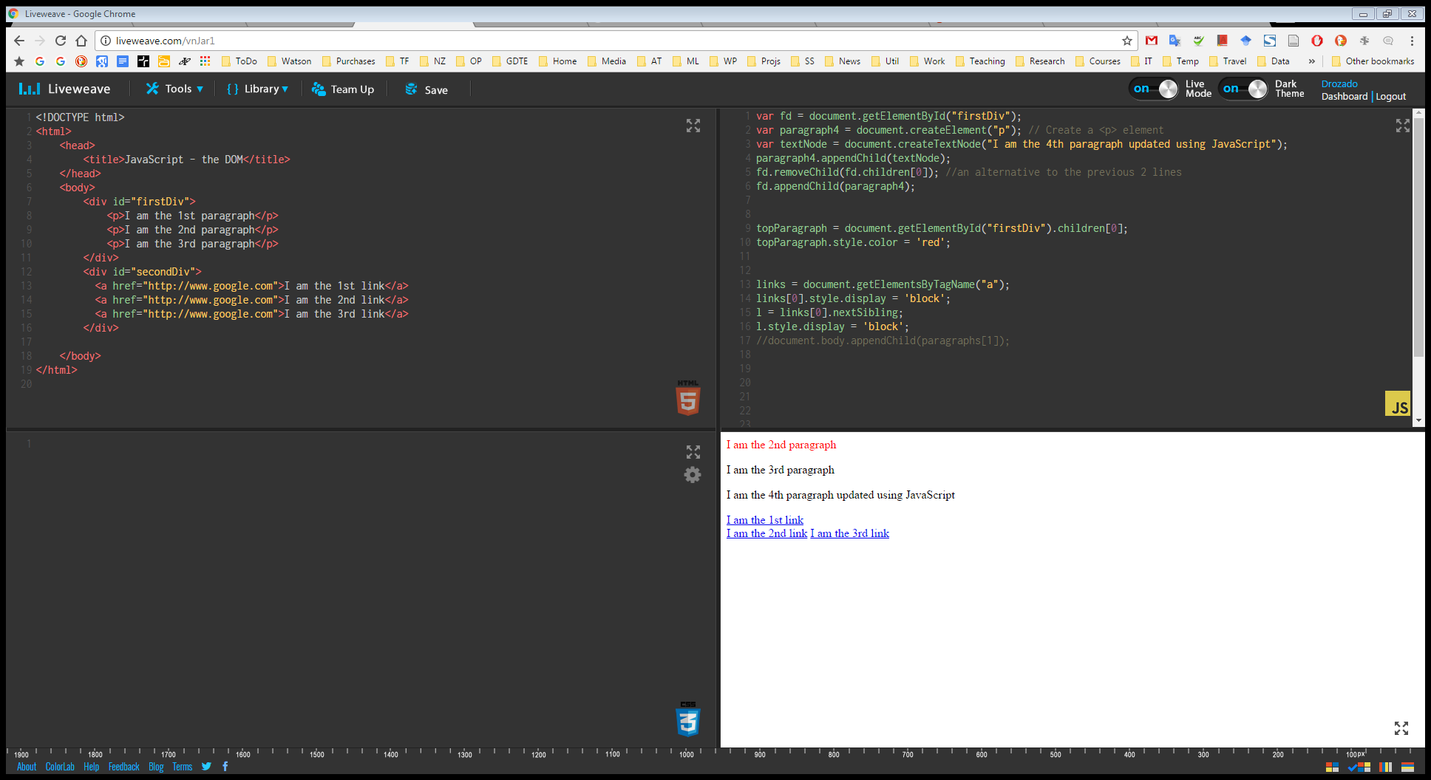
Demo

Slide 37
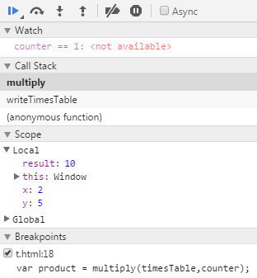
Javascript Debugging
Javascript debugging tools available for Internet Explorer, Firefox, Chrome, and Opera.
With these tools, you can halt the execution of your script with breakpoints and then step through code line by line to see exactly what is happening.
You can also find out what data is being held in variables and execute statements on the fly.

Slide 38
The following concepts apply to any debugger
Breakpoints tell the debugger it should break, or pause code execution, at a certain point.
Watches enable you to specify variables that you want to inspect when your code pauses at a breakpoint.
The call stack is a record of what functions and methods have been executed to the breakpoint.
The console enables you to execute JavaScript commands in the context of the page and within the scope of the breakpoint.
Stepping is the most common procedure in debugging. It enables you to execute one line of code at a time. You can step through code in three ways:
Step Into executes the next line of code. If that line is a function call, the debugger executes the function and halts at the first line of the function.
Step Over, like Step Into, executes the next line of code. If that line is a function, Step Over executes the entire function and halts at the first line outside the function.
Step Out returns to the calling function when you are inside a called function. Step Out resumes the execution of code until the function returns. It then breaks at the return point of the function.

